Slide 1
Adjective

Slide 2
Adjective
What is an adjective ?
Adjectives are words that describe or modify other words, making your writing and speaking much more specific, and a whole lot more interesting.
Examples: sharp, small, blue, glamorous, mischievous, intelligent

Slide 3
Adjectives are usually positioned before the noun or pronoun that they modify. Some sentences contain multiple adjectives.
Adjective examples in sentences:
They live in a big, beautiful bungalow.
2. Since it’s a hot day, Lisa is wearing a sleeveless
dress.
3. On her birthday, Brenda received an antique vase
filled with fragrant flowers.

Slide 4
Types of Adjectives
Possessive Adjectives
Demonstrative Adjectives
Numbers Adjectives
Interrogative Adjectives
Attributive Adjectives

Slide 5
Possessive Adjectives
Possessive adjectives are used to indicate possession. Possessive adjectives include my, your, our, his, her ,their and its.
Possessive adjectives in sentences:
I think you forgot your purse.
We began our work at noon.
Malacca is famous for its historical buildings.

Slide 6
Demonstrative Adjectives
Demonstrative adjectives are used to indicate or demonstrate specific people, animals, or things.
These, those, this and that are demonstrative adjectives.
Demonstrative adjectives in sentences:
1. These books belong to Johnathan.
2. This novel is one of my favourite collections.
3. Please put those cookies on the blue plate.

Slide 7
Numbers Adjectives
When they’re used in sentences, numbers are almost always adjectives. You can tell that a number is an adjective when it answers the question “How many?”
1. He ate 23 hotdogs during the contest, and was
sick afterwards.

Slide 8
Interrogative Adjectives
Like all other types of adjectives, interrogative adjectives modify nouns. There are three interrogative adjectives: which, what, and whose. All three of these words are used to ask questions.
Interrogative adjectives in sentences:
1. Which option sounds best to you?
2. What time should we go?
3. Whose socks are those?

Slide 9
Attributive Adjectives
Attributive adjectives denote specific traits, qualities, or features.
There are different kinds of attributive adjectives:
Observation adjectives indicate value or subjective measures. Examples: real, perfect, best, interesting, beautiful, cheapest

Slide 10
Size and shape adjectives indicate measurable, objective qualities including specific physical properties. Examples: small, large, square, round, poor, wealthy, slow .
Age adjectives denote specific ages in numbers, as well as general ages. Examples: old, young, new, five-year-old.
Color adjectives indicate colour. Examples: pink, yellow, blue.

Slide 11
Origin adjectives indicate the source of the noun, whether it’s a person, place, animal or thing. Examples: American, Canadian, Mexican, French.
Material adjectives denote what something is made of. Examples: cotton, gold, wool.
Qualifier adjectives are often regarded as part of a noun. They make nouns more specific. Examples: luxury car, pillow cover.

Slide 12
Forming Adjective:
Comparative Adjectives
When two objects or persons are being compared, the comparative form of the adjective is used.
The comparative adjective can be formed in two ways:
Adding –er to the positive form of the adjective.
(When words of two syllables ending with ‘y’, change ‘y’ to ‘i’, and add –er to the end of the word.)
Adding the word more before the adjective.
.

Slide 13
Comparative
For example:
1. My essay is longer than yours.
2. This doll is prettier.
3. She is more beautiful than her sister.

Slide 14
Forming Adjective:
Superlatives Adjectives
The superlative is used to say what thing or person has the most of a particular quality within a group or of its kind. The superlative can be formed in two ways:
Adding –est to the positive form of the adjective.
(When words of two syllables ending with ‘y’, change
‘y’ to ‘i’, and add –est to the end of the word)
Adding the word most before the adjective.

Slide 15
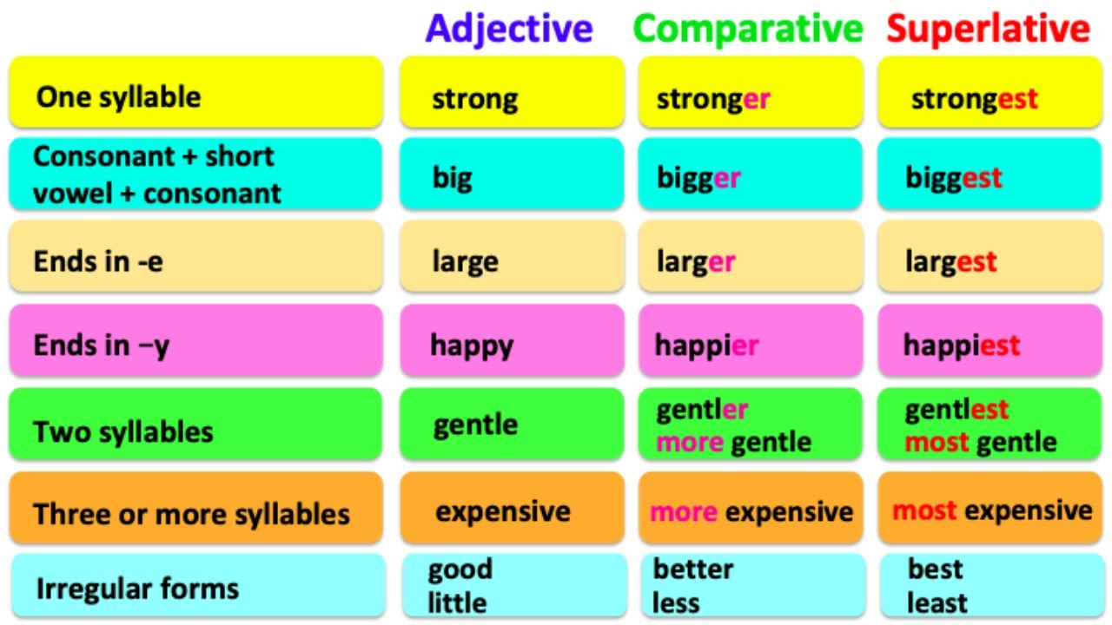

Slide 16
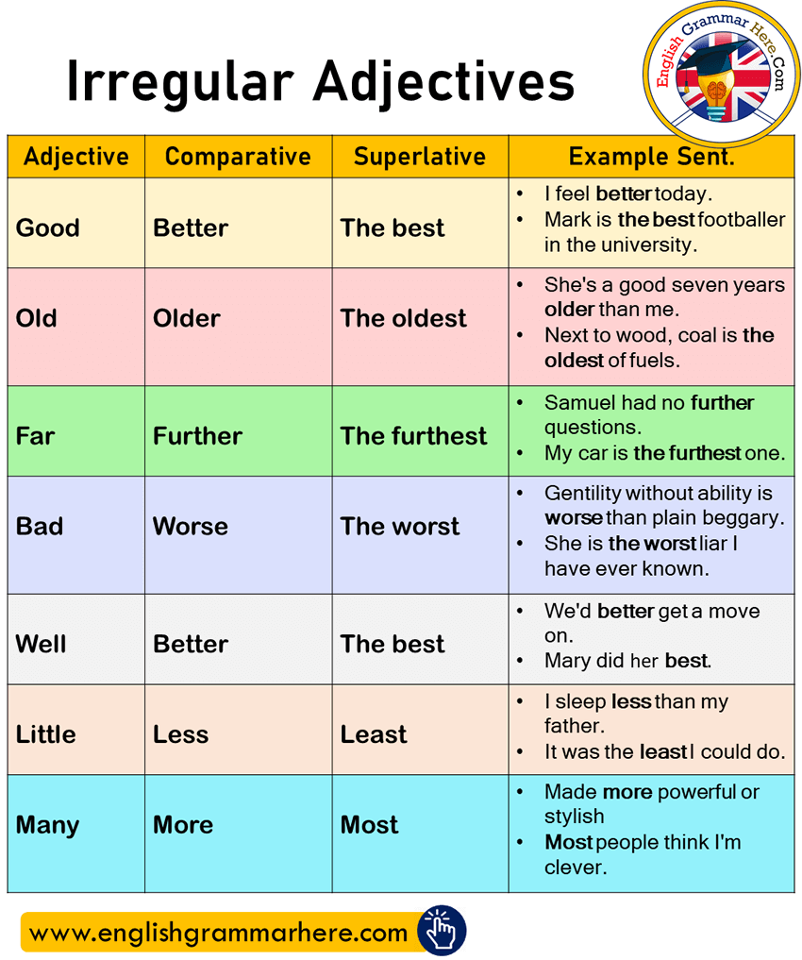

Slide 17
Exceptions (Irregular Forms)
Certain adjectives have irregular forms in the comparative and superlative degrees:
Positive | Comparative | Superlative
Good Bad Little Much/many/ some | Better Worse Less More | Best Worst Least Most

Slide 18
Superlative
For example:
Shirley’s hair is the shortest among all her siblings.
This doll is the prettiest.
This is the most beautiful dress I have ever seen.

Slide 19
Forming Adjective: Positive form
The positive form is used in cases where there are no differences between the two compared things or persons.
To form the positive, we use the word as before and after the positive form of the adjective.
For example: Danny is as smart as Phillip.
She is as beautiful as her elder sister.

Slide 20
Source
Adapted from : https://www.gingersoftware.com/content/grammar-rules/adjectives/

